Slide 1
STRASSEN'S MATRIX MULTIPLICATION

Slide 2
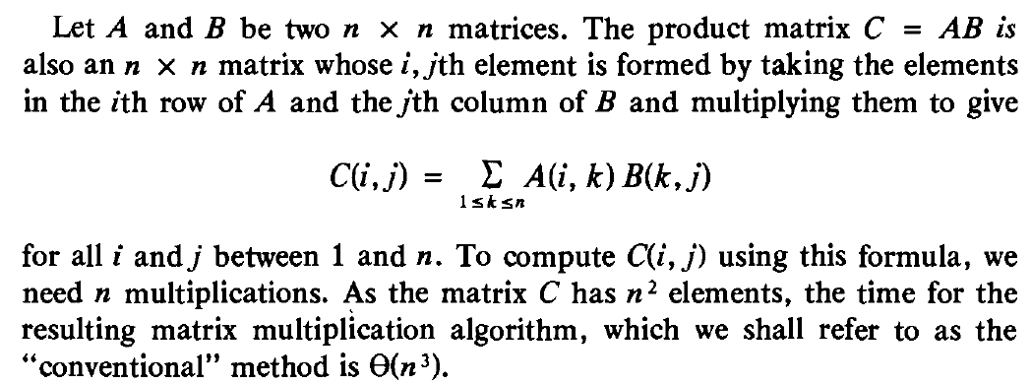
Conventional Matrix Multiplication

Slide 3
Divide and Conquer Strategy for matrix Multiplication
The divide-and-conquer strategy suggests another way to compute the product of two n x n matrices.
For simplicity we will assume that n is a power of 2, i.e. that there exists a nonnegative integer k such that n = 2^{k}.
Imagine that A and B are each partitioned into four square submatrices, each submatrix having dimensions n/2 x n/2.
Then the product AB can be computed by using the above formula for the product of 2 x 2 matrices.

Slide 4
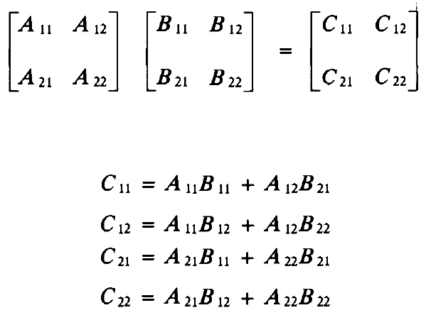
Divide and Conquer Strategy for matrix Multiplication

Slide 5
Divide and Conquer Strategy for matrix Multiplication
For n > 2 the elements of C can be computed using matrix multiplication and addition operations applied to matrices of size n/2 x n/2.
Since n is a power of 2, these matrix products can be recursively computed by the same algorithm we are using for the n x n case.
This algorithm will continue applying itself to smaller size submatrices until n becomes suitably small (n = 2) so that the product is computed directly.

Slide 6
Divide and Conquer Strategy for matrix Multiplication
In order to compute AB, we need to perform eight multiplications of n/2 x n/2 matrices and four additions of n/2 x n/2 matrices.
Since two n/2 x n/2 matrices may be added in time cn² for some constant c, the overall computing time, T(n) of the resulting divide-and conquer algorithm is given by the following recurrence.

Slide 7
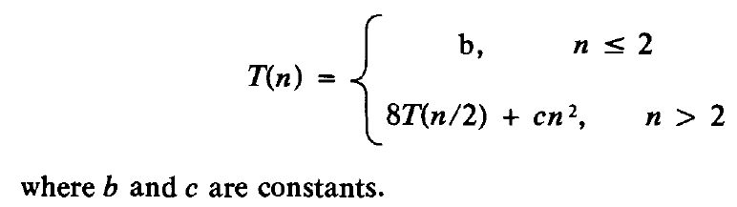
Divide and Conquer Strategy for matrix Multiplication

Slide 8
Strassen’s Method
Volker Strassen has discovered a way to compute the
C_{ij}s using only 7 multiplications and 18 additions or subtractions.
His method involves first computing the seven n/2 x n/2 matrices P, Q, R, S, T, U, V. Then the C_{ij}s are computed using the formulas shown in next slide.
As can be seen, P, Q, R, S, T, U, V may be computed
using 7 matrix multiplications and 10 matrix additions or subtractions.
The C_{ij}s require an additional 8 additions or subtractions.

Slide 9
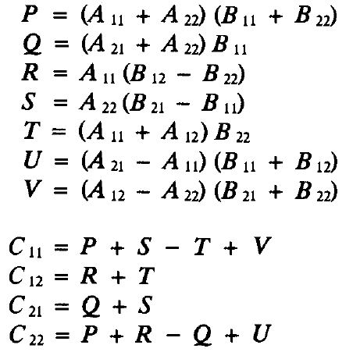
Strassen’s Method…

Slide 10
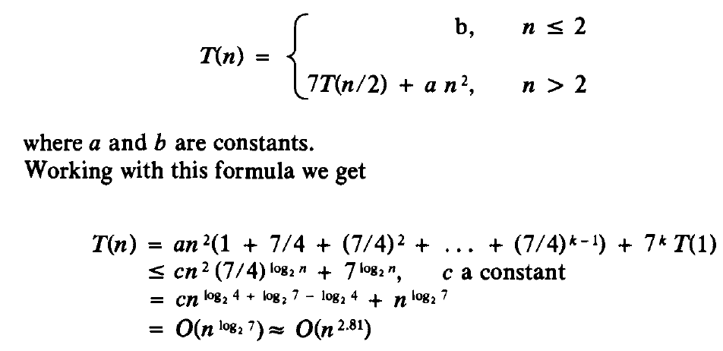
Complexity of Strassen’s Method

